Slide 1
Lesson objective
Title: Translating shapes
Aim - be able to:
Plot points on a cartesian plane
Describe and perform translation
Plan:
Algebra review
types of 3D drawings
Plotting points
Translation
Do you remember?
Coefficient
Pronumeral
Index number/power

Slide 2

Daily review – pronumerals
Identify the following for each term:
$3x^{2}$ $23y^{5}$
Co-efficient:
Pronumeral:
Power/indices/exponent :
Co-efficient:
Pronumeral:
Power/indices/exponent :

Slide 3
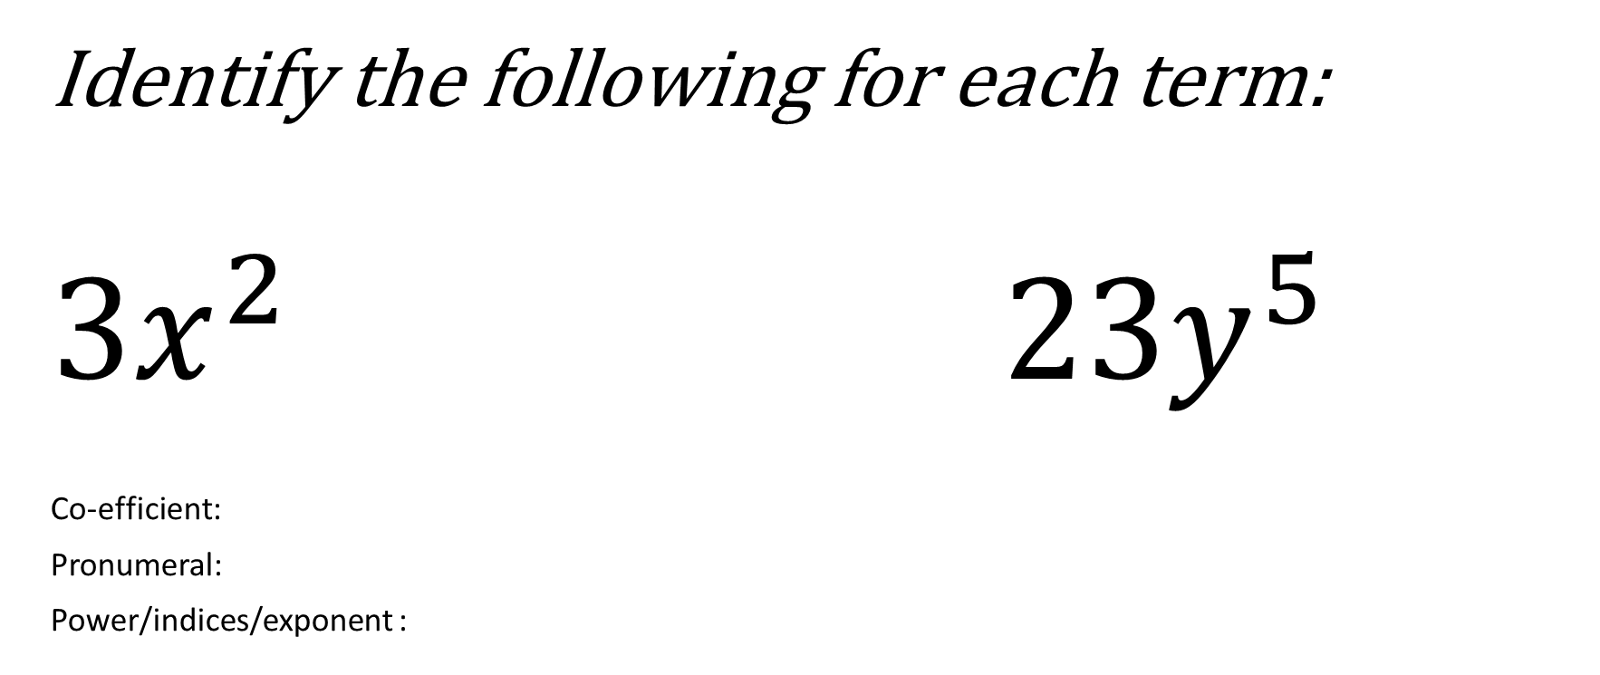
Daily review – pronumerals
Identify the following for each term:
$3x^{2}$ $23y^{5}$
Co-efficient:
Pronumeral:
Power/indices/exponent :
Co-efficient:
Pronumeral:
Power/indices/exponent :

Slide 4
Daily review – like terms
Like terms use the exact same pronumeral and the same power.
Like terms use the ____ same pronumeral and the same power.
Like terms use the _____ same _________ and the same power.
Like terms use the _____ same _________ and the same ______

Slide 5



Simplify by collecting like terms (exercise books)
$$9c + 2c =$$
$$2x^{3}+7x^{3}=$$
$$14f −6f=$$
$$22x+4c −9x=$$
$$7x^{2}−2x^{2}+8x$$
$$12c^{6}+2c −4c=$$
$$3p^{4}+3p^{2}−3p^{4}=$$
$$22x+x^{2}−9x^{2}=$$
$$\left(3×2x^{2}\right)+\left(5×x^{2}\right)=$$
$$\left(7x×2x\right)−4x^{2}=$$
$$3x^{2}×2x^{2}=$$
$$2x^{2}×3x^{0.5}=$$

Slide 6
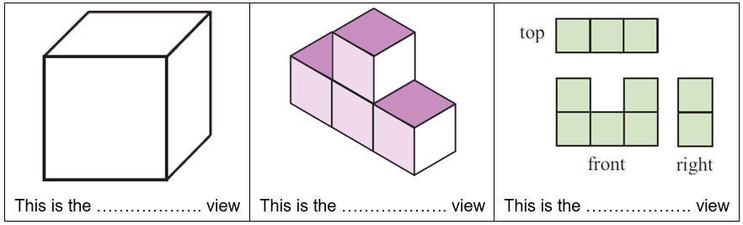
Types of view
Oblique (Flat face)
Isometric (diagonals)
Orthogonal (top, front and view)

Slide 7
Types of view
Oblique (Flat face)
Isometric (diagonals)
Orthogonal (top, front and view)

Slide 8
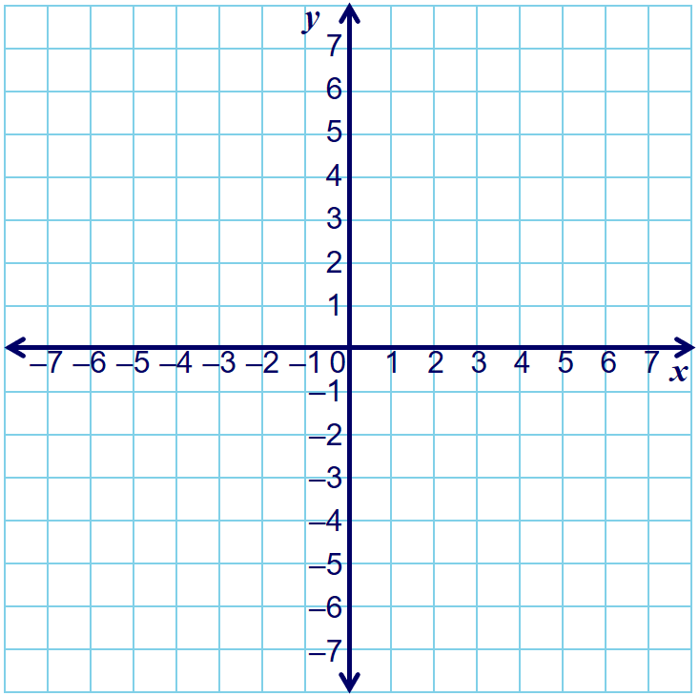
Co-ordinates
x
(3 , 6)
Now you plot:
(6 , 2)
(1 , 3)
x
(5 , -4)
(-3 , 3)
x
(0 , -7)
(-4 , -6)
x
x
x
x
x
x
x
x
(-2 , 4)
(7 , -2)
x
(-1 , -5)
(4 , 5)
x
(-7 , 0)
(-5 , 2)
x
Co-ordinates locate a point on the Cartesian plane
As babies, you learn to
    “Crawl along before you climb up or down”
Along first; up or down second

Slide 9
Co-ordinates
Plot and join these points in order to form a shape:
x
x
x
x
x
x
x
x
x
x
x
Co-ordinates locate a point on the Cartesian plane
As babies, you learn to
    “Crawl along before you climb up or down”
Along first; up or down second

Slide 10
Co-ordinates
(3 , 6)
Now you plot:
(6 , 2)
(1 , 3)
(5 , -4)
(-3 , 3)
(0 , -7)
(-4 , -6)
(-2 , 4)
(7 , -2)
(-1 , -5)
(4 , 5)
(-7 , 0)
(-5 , 2)
Co-ordinates locate a point on the Cartesian plane
As babies, you learn to
    “Crawl along before you climb up or down”
Along first; up or down second

Slide 11
Co-ordinates
Plot and join these points in order to form a shape:
Co-ordinates locate a point on the Cartesian plane
As babies, you learn to
    “Crawl along before you climb up or down”
Along first; up or down second

Slide 12
Translation is just a slide
When an object is moved in a straight line in a given direction, we say that it has been translated.
As an example, we can translate triangle ABC 5 squares to the right and 2 squares up:
A’
image
A
A
A
A
A
A
A
A
Crawl along before you climb up or down
C’
B’
object
object
object
object
object
object
object
object
object
C
C
C
C
C
C
C
C
B
B
B
B
B
B
B
B
Every point in the shape moves the same distance in the same direction.
Notes:
Introduce the key terms and ask pupils to give examples of translations from everyday situations. For example, walking in a straight line from one side of the room to the other.
Discuss how to define a translation. There are two ways to mathematically describe slide in a straight line in a given direction. One is to to give the direction as an angle and a distance (see S7 Measures – bearings), the other is to give the direction using a square grid. A slide in a straight line can be given as a number or units to the left or right and a number of units up or down.
Point out that when a shape is translated each vertex (or corner) is moved through the given translation.
The slide across is always given before the slide up or down.
Ask pupils how we could return the translated shape back to its original position.

Slide 13
Translation
Translation
Is just a slide
Describing a translation involves saying how many units a shape is shifted left, right, up or down.

Slide 14
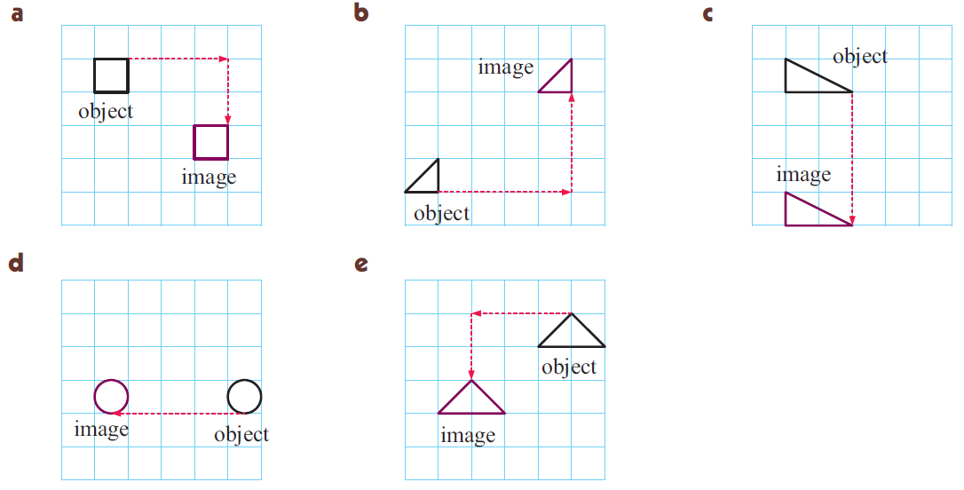
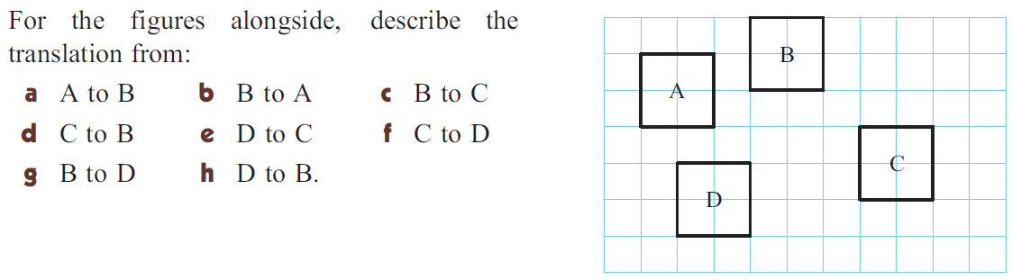
Translation is just a slide
Choose corresponding corners
Crawl along before you climb up
3 right 2 down
4 right 3 up
4 down
Exercise books!

Slide 15
Individual practice
Complete the task sheet provided

Slide 16
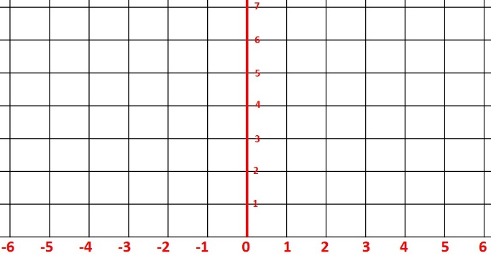
L
R
L.O: To explain how a shape has been translated
2
1
1
1
2
2
First of all, choose one corner on the first shape.
After that, identify the same corner on the translated shape.
Finally, explain how it’s been translated. This one is Right 6 spaces, Up 1 space.
2
2
2
1
1
1
1
2
1
2
1
2

Slide 17
L
R
L.O: To accurately translate a shape
Translate the shape Left 6, Down 2
Translate the shape Right 5, Up 1
Translate the shape Left 7, Down 3
Translate the shape Left 6, Up 4
Translate the shape Right 5, Up 2
Translate the shape Right 2, Up 2
Translate the shape Right 5, Down 3
Translate the shape Left 7, Down 4
Translate the shape Left 10, Down 1

Slide 18

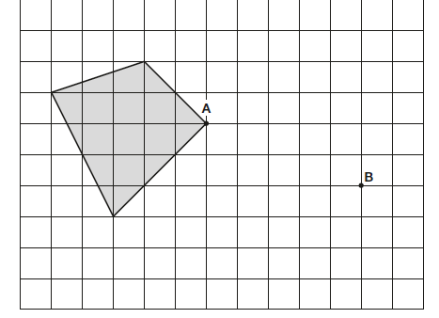
L
R
L.O: To accurately translate tricky shapes
Translate the shape Left 4, Down 1
Translate the shape Right 5, Up 1
Translate the shape Left 7, Down 3
Translate the shape Left 7, Up 3
Translate the shape Right 5, Up 2
Translate the shape Right 4, Down 1
Tip – Investigate how point A has been translated
to point B, and then do the same to the other corners.
Translate the shape Right 6, Down 2
Translate the shape Left 7, Down 2

Slide 19
Types of view
Oblique (Flat face)
Isometric (diagonals)
Orthogonal (top, front and view)

Slide 20
Individual practice
If you are unsure:
Start on page 393, read and begin from question 1 – 5
If you somewhat confident
- Start on page 394, question 3 – 8

